Slide 1
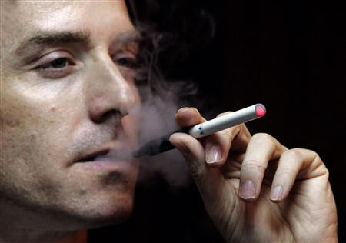
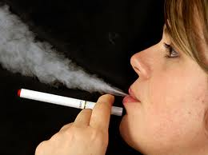
Smoking at Columbia

Slide 2
Evidence of smoking throughout the campus is ever present and extremely unattractive.

Slide 3
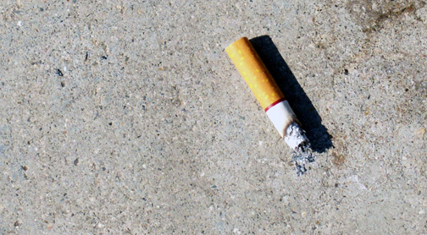
One Butt

Slide 4
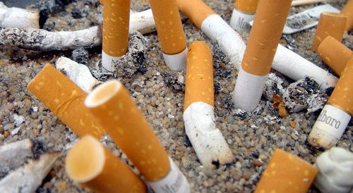
A Few Butts

Slide 5
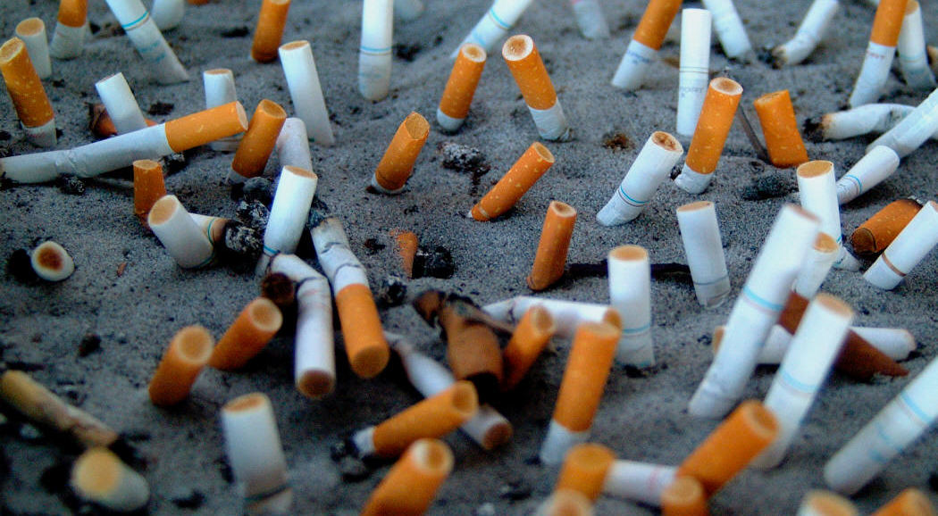
Butts Everywhere

Slide 6
The resolution that I am asking you to consider is not about aesthetics however.

Slide 7
Second Hand Smoke is a Public Health Issue
-According to the National Cancer Institute at the National Institutes of Health second hand smoke is dangerous at any concentration level.
-There is no safe threshold of exposure to second hand cigarette smoke.
-Second hand cigarette smoke has been proven to cause lung cancer and is suspected as a cause of a host of other cancers and other diseases.
-There are 7000 compounds that have been identified in second hand cigarette smoke.
-Of these 250 have been deemed harmful.

Slide 8
-These harmful chemicals include hydrogen cyanide, carbon monoxide and ammonia.
-Of these 250 chemicals, 69 are known carcinogens such as benzene, cadmium, polonium, 1,3 butadiene, ethylene oxide, chromium, vinyl chloride and nickel.
-As a result of the increasingly evident risks of second hand smoke, hundreds of municipalities and institutions, including colleges, have expanded smoking prohibitions from indoor to indoor and outdoor spaces.

Slide 9
Smokers’ Health Care Costs represent a significant public burden
-Various government studies have estimated that incremental health care costs, born by smokers, and paid for by all of us in the form of higher insurance premiums, exclusive of opportunity losses derived from lost wages, approximates $100 billion per year. Even if this is overstated, it still represents a staggering number.
-Curiously, smokers health care costs are diminished somewhat, in total, as a result of smokers’ shorter lifespans.

Slide 10
Yes, there is an issue of the contravention of individuals’ rights in considering this, however….
- Though we tend toward zealously guarding the rights of individuals, as a society, we often encroach upon those rights, selectively, in pursuit of a greater good.
-Consider, for example, the imposition of traffic rules and regulations.

Slide 11

Stop Signs

Slide 12

Traffic Signals

Slide 13
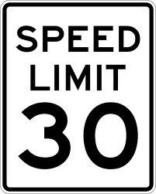
Speed Limits

Slide 14
A Smoke Free Columbia
-The 20 foot linear rule proposed by an interdisciplinary university task force, and adopted by resolution in the Senate last December is an inadequate measure, born of unwarranted compromise.
-The proposal was a good faith attempt to satisfy all campus constituents – but a compromise solution nonetheless.
-This measure, in my view , and the view of many of you here in the Senate, and throughout the Columbia community, is unacceptable to all but a small minority of smokers

Slide 15
-A strong indication of support for a more complete smoking ban was evidenced by 2/3 of this Plenary in the straw vote taken immediately following adoption of the current 20 foot rule.
-Much to the chagrin and irritation that many of you shared with me last spring, a new resolution which was to call for a more comprehensive smoking prohibition was tabled so that other issues such as ROTC, Disclosure, and Benefits could be addressed.
-It is now possible and appropriate for us to revisit this matter.

Slide 16
Please consider the following new resolution to replace the resolution enacted last December:
-Smoking shall be prohibited from all outdoor spaces contained within the Morningside Heights Campus including spaces within the East Campus and the outdoor bridge across Amsterdam Avenue between Philosophy and Greene Halls.
-The Morningside Campus is defined as the area bounded by 114th Street and 120th Street, and, Broadway and Amsterdam Avenue and Morningside Drive.

Slide 17
-In addition, smoking will be prohibited from all campus and building entrances, and, the outside perimeters, of all Columbia University facilities and outside spaces not located on or in proximity to the Morningside Heights campus within a distance that is deemed acceptable, legally, by University Counsel. This would include, for example, Baker Field, Nevis Laboratories, Lamont Doherty, etc.
-This desire for consideration of greater scope than the Morningside Campus discussed last year, is at the request of members of the University Administration.
- This resolution intends to unambiguously prohibit smoking from all Columbia University environs consistent with rules and regulations presently enacted and being enacted at other educational institutions, as well as New York City and other municipalities throughout the country.

Slide 18
-This resolution intends to be compatible with, and aligned with, the smoking bans recently adopted by both the Columbia University Medical Center and Barnard College.
-Though this resolution will encroach upon a minority of individuals’ freedoms, it is intended to support the greater health and well being of the larger Columbia University community of students, faculty and staff.

Slide 19
Additional Considerations:
-This new resolution, if enacted, would be made effective as early in 2012 on a date certain, as deemed possible and appropriate by the University Administration in consultation with the University Senate.
-To facilitate further dialogue concerning this new resolution, a meeting will be held for University Senators and other members of the University community who wish to participate between now and the next Plenary in October.

Slide 20
-Though many Senators have expressed a desire to vote on this resolution now, others have asked that a vote be deferred until the October Plenary, to allow the above mentioned forum to occur, and, to take into account that many Senators here today are new. They may, understandably, wish more time to consider this matter.

Slide 21
In Conclusion:
-Columbia is an institution of higher learning and a bastion of principled thinking and action.
-As a governing body at Columbia, it is imperative that we have the courage and strength of conviction to take an important and leading role on issues such as this without compromise or regard for popularity or lack thereof.
-We should step up and do the right thing in this matter. Please join me in making Columbia University a Smoke Free Institution

